Slide 1



practice task
View in Power BI
Last data refresh:
5/5/2025 12:52:55 PM UTC
Downloaded at:
5/5/2025 10:24:59 PM UTC

Slide 2
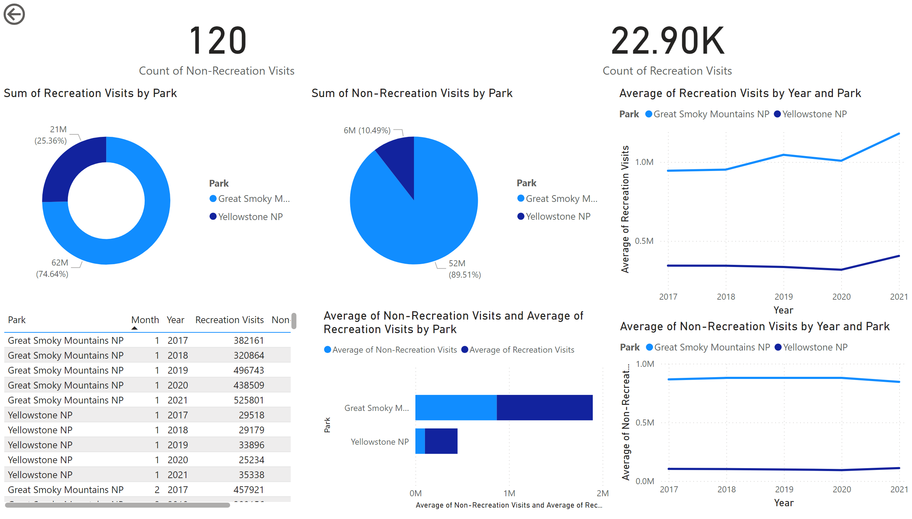
Page 1
Notes:
actionButton
No alt text provided
barChart
No alt text provided
lineChart
No alt text provided
National Parks Recreational and Non-Recreation al Visits
No alt text provided
pieChart
No alt text provided
tableEx
No alt text provided
donutChart
No alt text provided
kpi
No alt text provided
lineChart
No alt text provided
card
No alt text provided

